Slide 1


Slide 2
Project Management System
Presented By:
Ruchitha Padigapati(46281236)
Vara Lakshmi(46282339)
Surekha Kachana(46281313)
Lavanya Koyya(46282340)
Kalpana Challagundla(4628238)

Slide 3

CONTENTS
Abstract
What is the project management system
Modules
ER-diagram
Flowchart
Functional Requirements
Features
Benefits
Conclusion

Slide 4
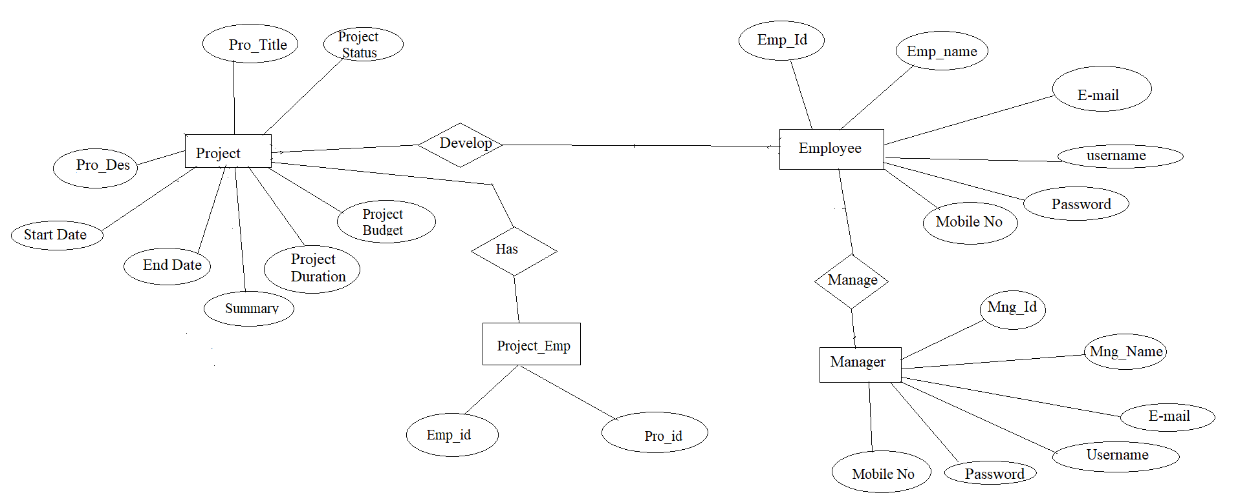
ER-DIAGRAM

Slide 5
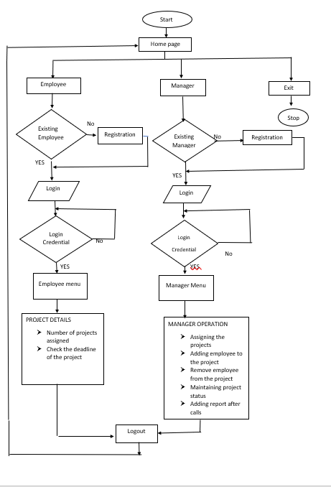
FLOWCHART

Slide 6
ABSTRACT
In this application is to plan ,execute and track projects of any size.
The purpose of this application how easily assign tasks and prioritize what's most important in your team.
And set projects timelines and milestones, track progress, and manage your teams entire workload all in one place.

Slide 7

WHAT IS PROJECT MANAGEMENT SYSTEM
* A project management system is a model for overseeing the execution of a project.
* It is designed to help businesses and individuals track projects, tasks and schedules.

Slide 8

MODULES
This application has 3 modules:
Employee module
Manager module
Employee manager data validation

Slide 9
FUNCTIONAL REQUIRMENTS
Employee Functionality:
int employeelogin(void);
void employeeregister(void);
int displaymenu(void);
Manager Functionality:
int Managerlogin(void);
int Managerregister(void);
int Addemployeetoproject();
int Assignaproject();
int Removeemployeefromproject();
int Maintainaprojectstatus();
int Addreports();

Slide 10
FEATURES
Login
Register
Data validation

Slide 11

BENEFITS
Managers handle multiple projects all the time
Track progress
Improved planning and scheduling
Easier integration of new members

Slide 12

THANK

Slide 13

CONCLUSION
In this project management system it helps to detail what tasks will be accomplished, who will be involved in completing the tasks, and when tasks should start and finish.

